Slide 1
Presentation
on
Introduction of Television

Slide 2
Submitted To: Md Imran Hossain
Associate professor
Dept. Of ICT
Comilla University Submitted By:
Md:Tareq Rahman
ID NO:11809012
Dept. Of ICT
Comilla University

Slide 3
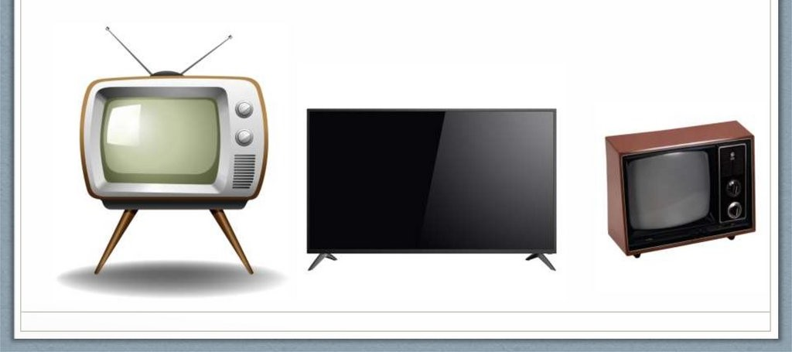
What is Television Television comes from the words tele (Greek for far away) and vision (sight). Television (also known as a TV) is a machine with a screen. Televisions receive broadcasting signals and change them into pictures and sound.

Slide 4
The History of Television Electronic television was first successfully demonstrated in San Francisco on Sept. 7, 1927. The system was designed by Philo Taylor Farnsworth, a 21-year-old inventor who had lived in a house without electricity until he was 14.

Slide 5
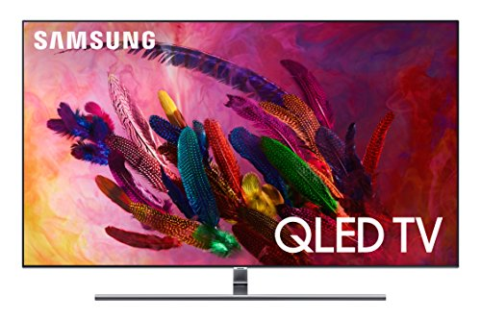
Types of Television 1.Quantum Light-Emitting Diode (QLED) Just a few years old, quantum light-emitting diode (QLED) displays are the next generation of LCD displays. Tiny nanoparticles called quantum dots are emended in the LCD display, which dramatically improves color and brightness. OLEDs still have better contrast ratios over QLEDs, but QLED screens can be larger, last longer, and are not susceptible to burn-in. Plus, QLED TVs are more affordable than OLED TVs, ranging between LCDs and OLEDs in price.

Slide 6
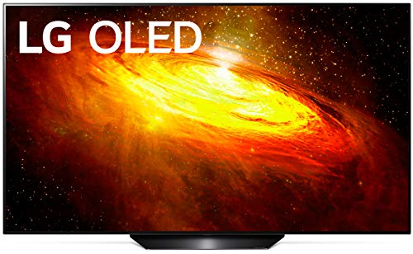
2.Organic Light-Emitting Diode (OLED) Display An organic light-emitting diode (OLED) display contains an organic compound that emits light in response to electricity. The organic compound, which can be small molecules or polymers, is situated between two electrodes, at least one of which is transparent for viewing the fluorescent compound clearly. Unlike LCDs, no backlighting is required since the compound itself is light-emitting, so OLEDs can display deeper blacks than LCD screens and generally display greater contrast ratios in ambient light. They can also be even thinner and lighter than LCDs because filter layers are not required.

Slide 7
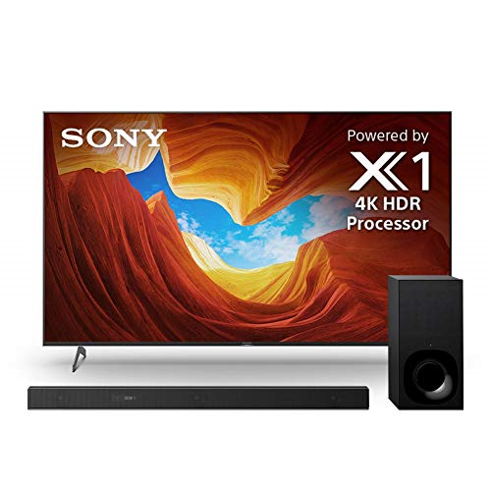
3. LED TVs An LED TV is actually an LCD TV that’s backlit with light-emitting diodes (LEDs) instead of standard cold-cathode fluorescent lights (CCFLs) [source: Cnet.com), so it’s not really all that much of a different type of television but because it’s marketed as LED instead of LCD, we are including it as a separate entry.

Slide 8
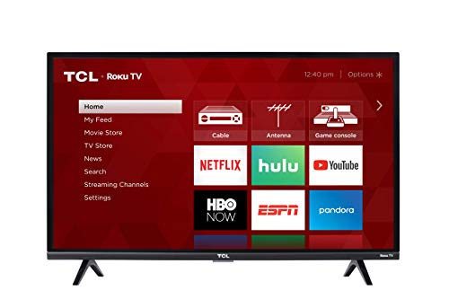
4. Liquid Crystal Display (LCD) Liquid Crystal Display TVs are by far the most common TV type available today. First conceived in the 1960s, LCD technology uses a unique state of matter called liquid crystals. In this state, molecules are fluid but retain a specific crystal structure such that they are all oriented the same way. For LCDs, each pixel of the display contains several precisely oriented liquid crystal molecules that are aligned between two electrodes and two polarizing filters. When the screen is inert, no light can pass through. But when an electric field is applied, the liquid crystals rotate to a degree dependent on the voltage applied, which lets a corresponding amount of light pass through the screen at that pixel. So, by applying different voltages to different pixels across the screen, an image can be viewed. Most LCD TVs today are backlit with LED lights, and are sometimes just referred to as LED TVs.

Slide 9
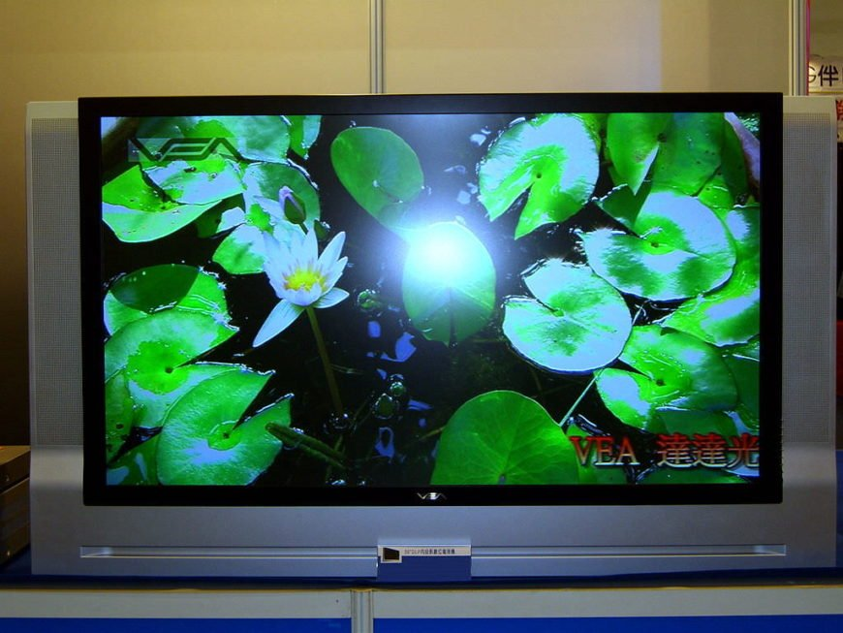
5. Digital Light Processing (DLP) Digital Light Processing (DLP) TVs were invented by Texas Instruments in the 1980s, using a completely novel technological approach. DLPs use an optical semiconductor chip with over 1 million mirrors that process digital signals by tilting to varying degrees, reflecting light in deferent directions to create an image. The resulting smooth viewing experience has several advantages over cathode-ray tube and plasma TVs, including longer lifespans, lighter weight, and 3D projection compatibility. However, newer technologies that are thinner, quieter, have faster response rates, and use less energy have also caused the shutdown of DLP TV production as of 2012. Used and refurbished models are available, with costs comparable to similarly dated plasma TV models.

Slide 10
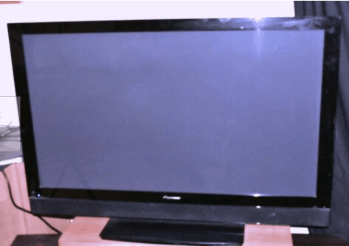
6. Plasma Panels Beginning in the 1990s, plasma display panel TVs became the first flat screen alternative to cathode-ray tube technology. Plasma displays are designed as a cellular grid with pixels that contain plasma, an ionized gas that responds to electric fields. The plasma layer is flanked by electrodes, with glass panels in the front and rear. Plasma TVs use similar phosphor screens as cathode-ray tube TVs, making the color depth similar in both technologies. However, plasma screen technology has considerable faster frame response over cathode-ray tubes, refreshing up to 600 times a second (600 Hz). Plasma TVs are also easily scalable — the first flat, big screen systems were all plasma displays.

Slide 11
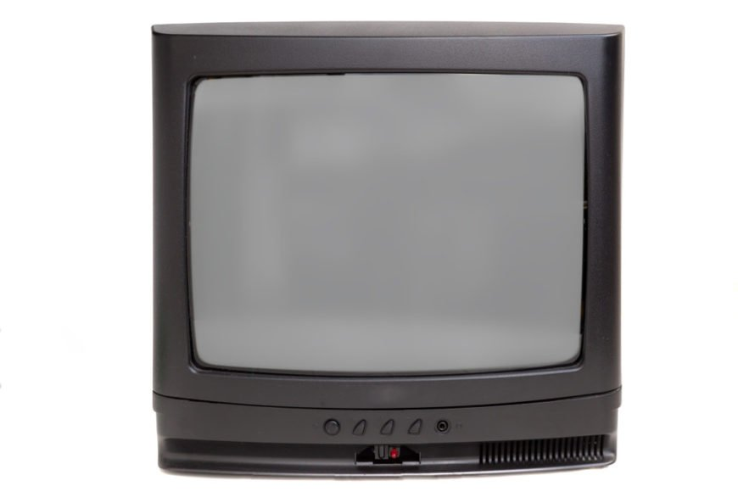
7. Direct TV Direct View TVs are a rebranding of the classic, century-long dominance of the cathode-ray tube TVs. Unfortunately, if you’re looking to buy a new direct-view TV you’re probably out of luck. Most TV manufacturers have ceased production on these models in most countries in favor of newer technologies. However, don’t completely disregard the cathode-ray tube TV as an option to keep around. If you’re into gaming, especially older gaming, having a direct view TV may be important.

Slide 12
The Importance Of Television Television is one of our world's most important means of communication. It shows us information programs, like the news, documentaries, and sports events. We can watch films, listen to interviews and hear the sounds of events that happen far away.

Slide 13
THANK YOU

